Slide 1
Digital Portfolio
Name: Manikandan.R
Register no and NMID:A9FDABD4C1787828A6E4146FFE141CE8
Department:B.C.A
College: Prince shri Balaji Arts and Science college / university of madras

Slide 2
PROJECT TITLE:
STUDENT DIGITAL PORTFOLIO

Slide 3
AGENDA :
1.Problem Statement
2.Project Overview
3.End Users
4.Tools and Technologies
5.Portfolio design and Layout
6.Features and Functionality
7.Results and Screenshots
8.Conclusion
9.Github Link

Slide 4
PROBLEM STATEMENT:
In today’s digital era, many students struggle to effectively showcase their skills, academic achievements, and personal growth in a structured and accessible way. Traditional methods, such as paper files or basic resumes, often fail to represent a student’s full potential and are difficult to update or share. There is a growing need for a digital platform where students can organize, display, and share their work easily with teachers, peers, colleges, and employers.

Slide 5
PROJECT OVERVIEW ;
This project is a personal portfolio website created using HTML, CSS, and JavaScript.
It showcases my profile, skills, and projects with a clean and responsive design.
The site includes sections like About Me, My Projects, and a Contact Form for easy interaction.
It serves as a platform to highlight my web development learning journey and projects.

Slide 6
WHO ARE THE END USERS;
If the end users are students, they could be:
1. Classmates or friends – who want to see your projects for ideas or inspiration.
2. Team members – collaborating with you on group projects or hackathons.
3. Junior students – learning from your code and portfolio structure.
4. Peers in tech communities – connecting for networking, knowledge sharing, or project collaboration.

Slide 7
TOOLS AND TECHNOLOGIES :
HTML – to structure the content of the website.
CSS – for styling, layout, and color themes.
JavaScript – for interactivity, such as the menu toggle and form behavior.
Mention code editor CODEPEN and Treb edit (GitHub Pages)

Slide 8
PORTFOLIO DESIGN PORTFOLIO AND LAYOUT ;
1. Header – Links for Home, About, Projects, and Contact.
2. Hero Section – Introduction with your name, tagline, and a "View My Work" button.
3. About Me Section – Profile photo, brief bio, and academic details.
4. Projects Section – Cards for Project 1, Project 2, and Project 3 with short descriptions.
5. Contact Form – Simple form with fields for name, email, and message plus a send button.
6. Responsive Design – Adjusts well to mobile, tablet, and desktop screens.

Slide 9
FEATURES AND FUNCTIONALITY:
Responsive Design – Works smoothly on mobile, tablet, and desktop devices.
Clean Navigation – Easy-to-use menu for quick access to sections like About, Projects, and Contact.
Interactive UI – Buttons and links with hover effects for a modern look.
Smooth Scrolling – Seamless transition between sections when clicking navigation links.
Clickable Links – Projects link to live demos or code repositories.
Responsive Layout – Automatically adjusts grid and text alignment based on screen size.

Slide 10
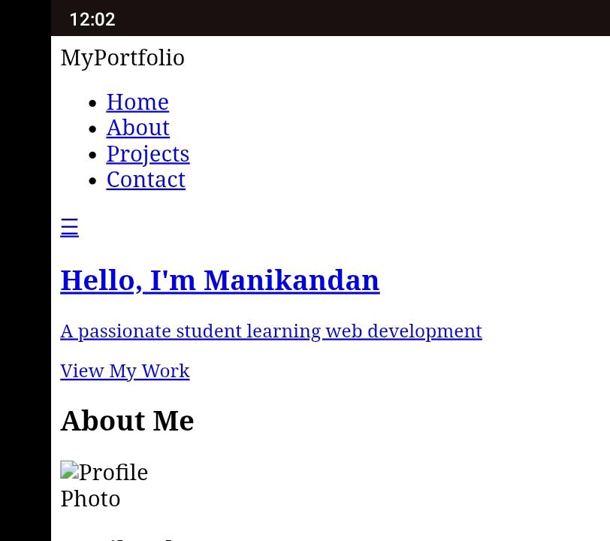
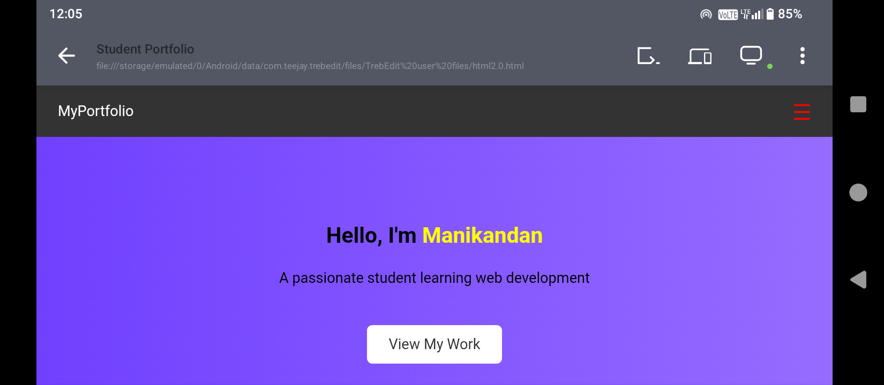
RESULTS AND SCREEN SHOT:
HTML
CSS

Slide 11
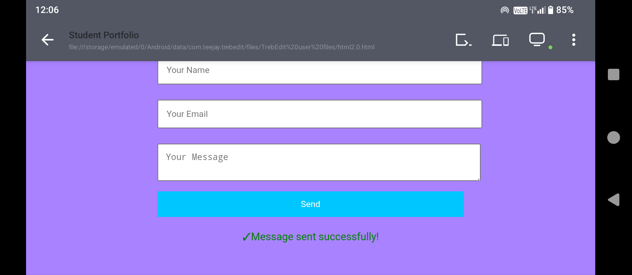
JAVA SCRIPT

Slide 12
CONCLUSION:
This portfolio project effectively showcases my skills, projects, and learning journey in web development. It provides a clean, responsive, and user-friendly platform for students, recruiters, and peers to explore my work. Through this project, I have gained practical experience in HTML, CSS, and JavaScript, as well as in responsive design techniques. This portfolio will continue to grow and improve as I enhance my skills and complete more projects.

